Slide 1


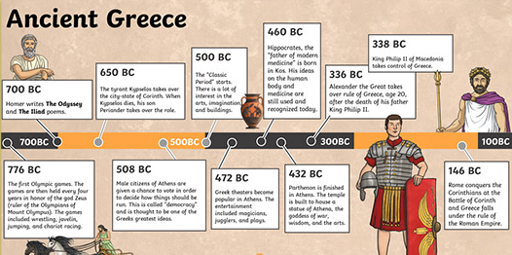
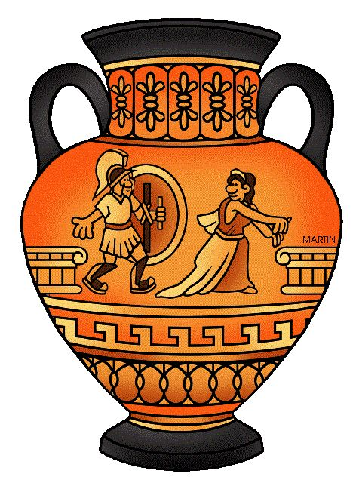
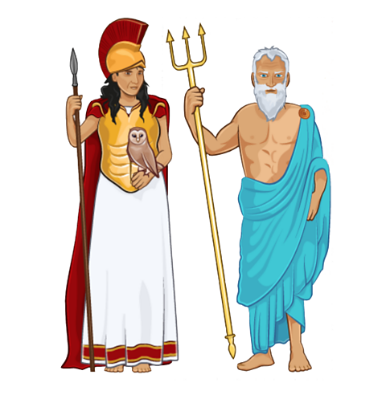
My Continent – Europe (Year 5)
What impact have the Ancient Greeks had on Britain today?
In year 5, we learn about life in Ancient Greece, their biggest achievements and the influence that they have had on the world, particularly Britain, such as our modern-day democracy and British values. We compare differences between living in Ancient Greece and modern-day Britain and the rest if the Western World.
Key Learning
To know that King Alexander developed the Greek alphabet and compare the symbols to our language.
To know that democracy was created in Ancient Greece and how this links to democracy in the UK.
To know how life was different in Ancient Greece compared to our lives today.
To know that Ancient Greek civilization eventually became weak and was eventually conquered by the Ancient Romans in 146 BC.
To know the importance of Greek God’s and Myths in Ancient Greek society.
Vocabulary
democracy | Democracy means 'rule by the people’. The people elect the government.
hoplite | A citizen soldier of the Ancient Greek city-state.
myth | Myths are old tales filled with magical creatures, gods and mystery
philosophy | It means ‘love of wisdom’ it is how we think.
artefacts | An item made by humans in the past
Parthenon | An Ancient Greek temple located in Athens, Greece.
Athenians | A citizen or resident of Athens.
Spartans | A citizen or resident of Sparta.

