Slide 1
When we look around our unit in September we couldn’t tell you who crawled first, who walked before they were one or spoke in sentences by 18 months. We couldn’t tell you if their parents breast fed or bottle fed. No idea if they were potty trained at 2 or if they still wear a pull up for bed.
What we can see is those children whose families value manners and kindness. Whose parents use different voices when they are read to through their joy of sharing books. We can see who is used to a routine and can take on some responsibilities. How children react to scary situations and what they find comfort in. We can hear how they are spoken to by how they speak to others.
When we look at our class of children we don’t see their milestones. We see who they are as a young person; their humanity, their actions, their inner voice, and most of all we see you and all the love you pour into them. And there is no greater start than that.

Slide 2


Welcome to
Whitegate End

Slide 3

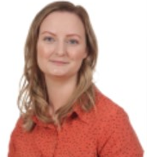
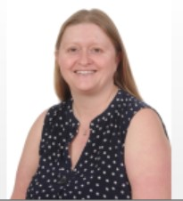
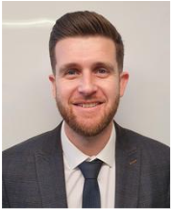
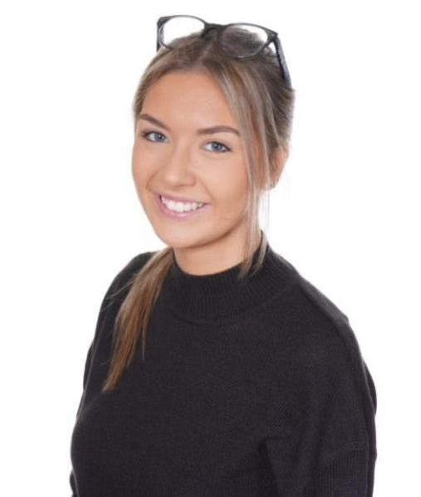
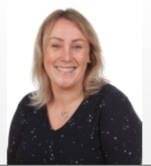
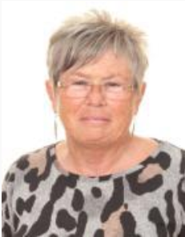
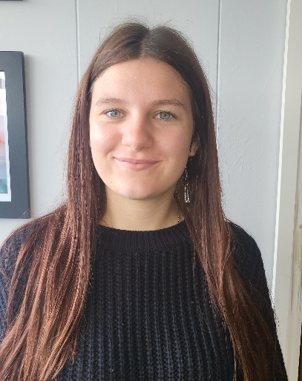
Meet the Early Years team
Mrs Smith
Nursery Lead
Mr Hollingsworth
Headteacher
Mrs Bingham
Deputy Headteacher
Mrs Nicholl
Early Years Lead
& Teacher
Miss Clifford
Teaching Assistant
Mrs MacMillan
Teaching Assistant
Miss Eaves
Teaching Assistant
Mrs McCartney
Lunchtime Supervisor

Slide 4
Our school day
Our number one priority in your child’s first weeks of school will be to form trusting relationships between the adults and the children and ensure every child feels safe, settled and comfortable in their new setting. It is in this time that we introduce children to the routines and procedures of the Early Years unit to ensure they can enjoy all there is on offer as independently as possible.
When the children are ready, a specific weekly timetable, including all of the elements below, is introduced. The weight of these activities change throughout the year to meet the everchanging needs of the children. The timetable will include:
Focused teaching sessions
Whole class carpet times
Includes all staff
Used to teach phonics, maths, PSED, music, topic sessions

Slide 5
Adult led activities
Children access these activities during play times
All members of staff take part in delivering these activities
They aim to support children in meeting aged related objectives in reading, writing, the arts, maths and topic related objectives
Some adult led activities will also be ‘Rainbow Challenges’
Additional activities
Includes P.E/dance, assembly, story times, library sessions, TIM Time
Music (Tune into Talking programme, Mrs Preen)
Interventions
Rainbow Challenges
The children will also have the opportunity to complete weekly challenges known as The Rainbow Challenges (more information to follow in the Autumn Term)
But most importantly the timetable will offer lots of time for…

Slide 6
Play!
As Early Years practitioners we never underestimate the importance of play. The life long skills, brain development, opportunities to practise resilience, understanding of relationships and new experiences it offer is integral to your child’s future.
Explore
Discover
Imagine
Converse
Participate
Respond
Focus
Negotiate
Express
Observe
Remember
Consider
Try
Evaluate
Adapt
Analyse
Achieve
Apply
LEARN!
Notes:
Video
https://www.youtube.com/watch?v=aISXCw0Pi94

Slide 7

Seesaw (New children only)
Please download the apps onto your phone or tablet. If you have multiple children who need to access Seesaw it is a good idea to have them set up on separate devices so that you never have to log a child out.
The Seesaw Family app is used as a method of communication between parents and teachers. You will get handy reminders and messages sent via this app so you don’t miss a thing.
Your child will receive a new Seesaw code in September which will be the account for the whole academic year. Seesaw is only used in Early Years.

Slide 8
Let’s work together
Reading books (Reception children only)
In September 2022 Whitegate End began a new phonics and reading programme called Little Wandle. As part of the programme your child will access the same book at home as they are reading with an adult in school. There will be a new book each week. Children and their parents will access the books electronically from home. Books are assigned after school every Monday.
Library books
All children from Nursery – Year 6 will bring a library book home with them each week. Nursery and Reception will change their book in the library every Friday.
Activity Sacks
In the Early Years entrance we have a range of Activity Sacks for you to take home for a week. They each include a story with lovely activities you can do with your child.

Slide 9
Adventure Books
Your child’s Adventure Book will be located in the Early Years entrance. You are welcome to pop in to have a look at drop off and pick up times to browse the photographs and records of all the exciting things your child has been up to.
Reporting to parents
There are two progress meetings for Reception children throughout the academic year; in the Autumn and Spring terms. All parents receive a written report about your child’s progress at the end of each year.
Open Afternoons
There is an open afternoon around the end of each half term. Parents/family members are welcome to come into school at 2pm and spend some time with their children in school, joining activities and finding out about what they have been learning.

Slide 10
Family Learning sessions
There are three fantastic family learning sessions you are invited to attend throughout the year. Two sessions (Reading and Maths) usually take place before Christmas. And the final session focused on Writing in early Spring. Sessions include a presentation in the school hall about the theory behind our teaching and how you can help at home, followed by a ‘see it in action’ session in the Early Years unit where you will join your child in play.
‘I felt I could come away from the workshop
and have the confidence to implement the
skills talked about at home. Definitely a morning well spent!’
‘This workshop has put me at ease with my children’s development and has given me ideas to help them to progress.’
‘What a great way of letting parents gain
insight into how our children are learning!’

Slide 11
What next for children new to our school?
Home visits
Please sign up to the most suitable appointment.
Stay and Play
On Monday 2nd September 1:30-2:30pm you and your child are invited to a Stay and Play session in our Early Years unit where the children will be able to explore the setting, resources and outdoor area for the very first time and, of course, the Early Years Team will be there for a chat too. Parents also really benefit from this session as it gives them an insight into where their children will be spending so much of their time over the next year/two years.
Starting school
All Reception children will start, full time, on Tuesday 3rd September.
Nursery will have a staggered start with all children in by the end of the first week. You will be given your child’s start date at your home visit appointment.
Times
Full time – 8:30am-3.00pm
Part time morning (Nursery only) – 8:30am-11:30am
Part time afternoon (Nursery only) – 12.00pm-3.00pm

Slide 12
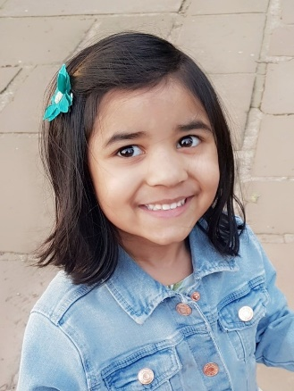
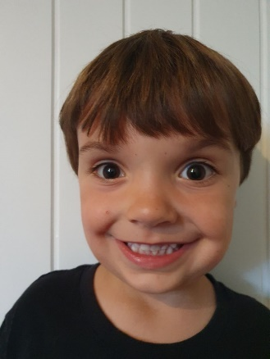
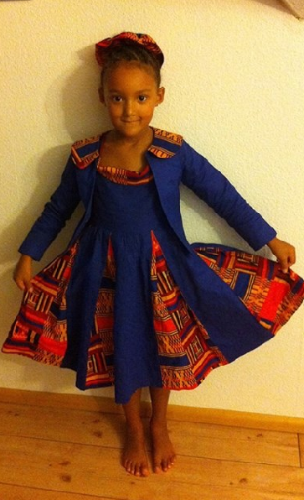
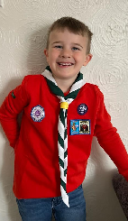
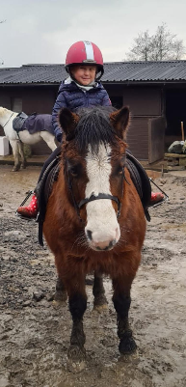
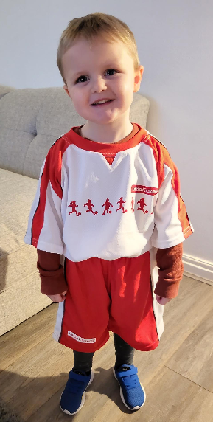
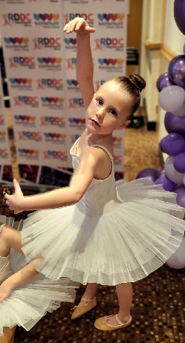
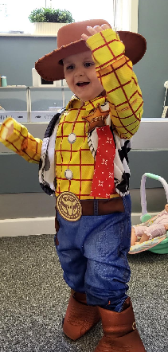
Heads up!
Photos
To help us to get set up for September you will shortly receive a Seesaw message asking for two photographs of your child.
A head a shoulders photo
A photo which makes your child unique! Could include hobbies and interests, favourite dressing up, a link to their culture, a favourite place etc

Slide 13
Water bottles
During our Stay and Play session in September your child will be given a Whitegate End water bottle to bring to school each day, filled with water. We find, even with a permanent marker, the children’s names are washed off very easily. Some parents have labelled their child’s bottle with a water proof name sticker which we thought was a great idea!!
Birthdays
Unfortunately, we do not give out party invitations unless the whole class is invited (which we completely understand is difficult and expensive!) as this can be a really upsetting time for those children who do not receive an invitation. Also we cannot give out sweets for children’s birthday due to being part of the Healthy Schools initiative – some parents send in bubbles or donate a book etc instead but this is by no means expected!
P.E (Reception only)
You will be informed of your child’s P.E day in due course. On P.E day please send your child to school in their P.E kit and trainers, they will remain in these clothes for the whole day - we no longer get changed in school.

Slide 14
Uniform
Please see our school website for uniform requirements, including P.E kits. You will find this information under the Parents tab ‘Useful information’. Please ensure all items of uniform are labelled with your child’s name (stamps are best!) Please bare in mind if your child is coming home with their uniform dirty or untidy they have simple had a great day and are getting stuck in. This is a great sign of a child who has settled well!!
Always Badges
As part of our whole school behavior policy children are awarded an Always Badge to wear everyday as part of their uniform when they have been identified by staff as a great role model who consistently follow the Always promises. Once your child is award their badge please make sure they wear it everyday. Your child’s Always badge may be awarded in any year group.
Toilet training
If your child is still toilet training please provide a pack of wipes, nappy sacks and spare uniform which will be kept in your child’s changing draw.

Slide 15
Bumped head texts
Please do not be alarmed if you receive a text message to say your child has bumped their head. It is part of our first aid policy to send a text message to parents and is normal school procedure if your child has any form of accident which involves their head. If your child has a particular bad accident you will always be contacted by telephone.
Wellies
Please provide a pair of wellies labelled with your child’s name for them to keep on the welly rack in school, as the children access the outdoor area in all weather. We have waterproof overalls in school to protect clothes in particularly wet weather.
Snack
Children have free access to our snack area throughout the day, this can include raisins, apples, tangerines, carrots, pears. Please do not send a snack to school.

Slide 16
Questions?
If you have any questions at all regarding the information in this PowerPoint however big or small please phone or email the school office and ask for me (Mrs Nicholl)
Other questions you have regarding your admission or about our school generally, a member of staff in the office will be happy to help you.
We will be in touch again soon and can’t wait
to meet your little ones!

